Slide 1
Lecture 3: Selecting a Solution

Slide 2
Remember: last time
Data are diverse
  Continuous vs discrete
  Classification vs regression
  Abundant vs rare (or asymmetric)
  Multivariable
  Available at once vs flowing
  “Easily” modeled by statistical distributions

Slide 3
This time
Machine learning solutions are based on these (and other) factors:
  Eager vs lazy
  Batch vs online
  Parametric vs nonparametric
  Discriminative vs generative

Slide 4
Lazy learners
Instead of evaluating the training data, simply store it when it’s received
When test data appear, classification happens using the subset of the training data that is most applicable to the test data

Slide 5
Eager learners
Construct a model for classification when the training data is given, before seeing the test data
Must be able to commit to a single hypothesis that can cover all data before seeing “all data” (the test data)

Slide 6
Eager learners
Construct a model for classification when the training data is given, before seeing the test data
Must be able to commit to a single hypothesis that can cover all data before seeing “all data” (the test data)
Eager learners often take a long time to train and less time to predict

Slide 7
Batch (offline) learning
“Standard” relative to online learning
  Has been done for a much longer period of time
  Is what most people would come up with if you described machine learning
  Other X vs Y’s don’t have a “standard”
Get a (training) dataset, build model with the dataset (which can be done in an eager or lazy way), then apply that model to another (test) dataset

Slide 8
Online learning
Online learning processes data one-at-a-time, so you technically don’t need to store data (although you generally do)
Online learning is adaptable because you don’t (can’t) make assumptions about the underlying distribution of the data
Can react to changes in the data (for example, if consumers are responding to an event in the world)

Slide 9
When to use online learning
Your data doesn’t fit into memory
You expect your data to change over time (although there are ways to deal with this in batch learning, potentially obviously)
Your data is a function of time and needs to be updated constantly (for example, stock prices)

Slide 10

Parametric learning
Stays firm with the number of parameters needed to explain the data
  No amount of training data will change the number of parameters
  The training data WILL inform the coefficients of these parameters
b0, b1, and b2 are coefficients that control the intercept and slope, x1 and x2 are variables

Slide 11
Parametric learning
Can be bad or really bad
  The previous example was modeling data as linear, but it may require a minor transformation to work out correctly
  Alternatively, it could be modeling extremely non-linear data, which will likely cause the model to fail spectacularly
Benefits of parametric learning:
  Simple. Easy to understand and interpret
  Fast. Can typically learn from data very quickly
  Not data hungry. Can often learn quickly from little or incomplete data

Slide 12
Parametric learning
Can be bad or really bad
  The previous example was modeling data as linear, but it may require a minor transformation to work out correctly
  Alternatively, it could be modeling extremely non-linear data, which will likely cause the model to fail spectacularly
Limitations of parametric learning:
  Constrained. By choosing a form, you’re held fast to that form
  Complexity. Only typically useful for low complexity problems
  Poor fit. In practice, data rarely fits very well to underlying model

Slide 13
Nonparametric learning
Do not make strong assumptions about the form of the mapping function
Seek the best fit of the training data while maintaining the ability to generalize in case of unseen data
“Nonparametric methods are good when you have a lot of data and no prior knowledge, and when you don’t want to worry too much about choosing just the right features.” (Artificial Intelligence: A Modern Approach, page 757)

Slide 14
Nonparametric learning
Benefits:
  Flexible
  Power (no assumptions make for powerful methods)
  Performance (can “fit” very well)
Drawbacks:
  Require a good amount of data
  Slow (both per unit data and because they require more data)
  Overfitting (we’ll talk about this more later, but nonparametric methods are more susceptible to overfitting, which is bad)

Slide 15
Discriminative vs generative learning -- analogies
You want to figure out what language someone is speaking:
  Generative – learn every language, determine which language the person is speaking by figuring out which one it belongs to
  Discriminative – determine linguistic differences without learning any languages
2 kids: 1 (“kid A”) learns by memorizing everything in depth, the other (“kid B”) learns the differences between what is seen. Both go to the zoo
  “A” identifies a photo of a lion based on the closest match to the zoo animals
  “B” identifies the same photo as a lion based on observed characteristics of lions

Slide 16
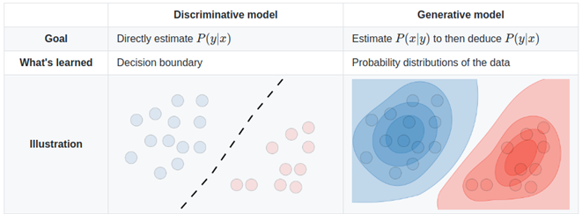
Discriminative vs generative learning
To put it another way,
  You can put together a model for what, say lions and tigers, look like, then you create a boundary that separates them. You can decide whether the current example falls in with the lions of the tigers (discriminative)
  You could also build a model for tigers, build a model for lions, then compare the current “test data” point against both the tiger model and lion model and find which it behaves more like (generative)

Slide 17
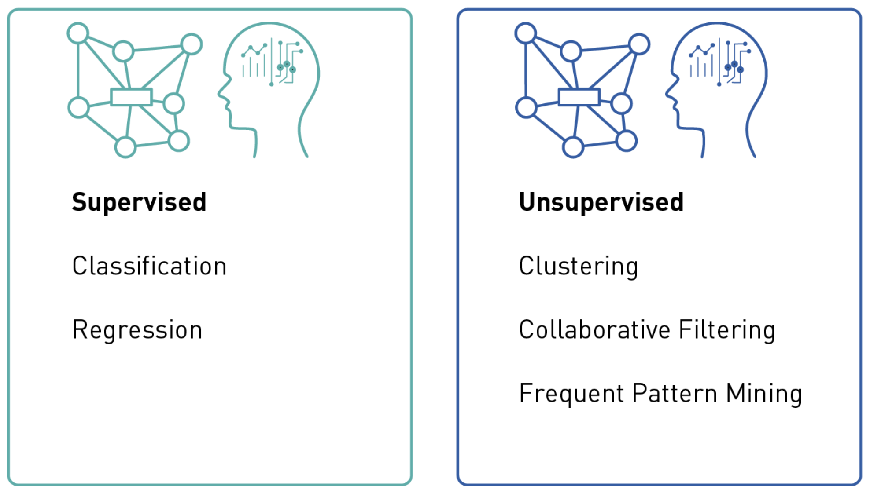
Additional consideration

